Slide 1

Visit Nepal 2020
As an opportunity for a young mind.

Slide 2
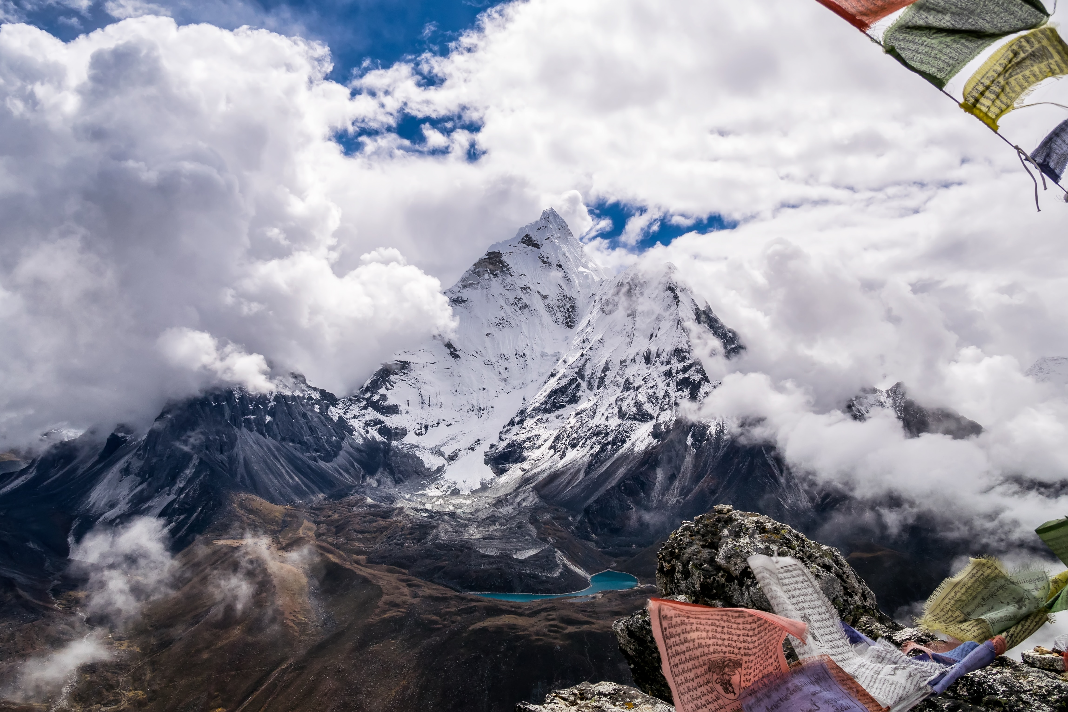
Lumbini City College
Elite Team
Presented By :
Suraj Gahatraj
Roshika Pant
Sandesh Kr. Shrestha

Slide 3



Technology Used

Slide 4
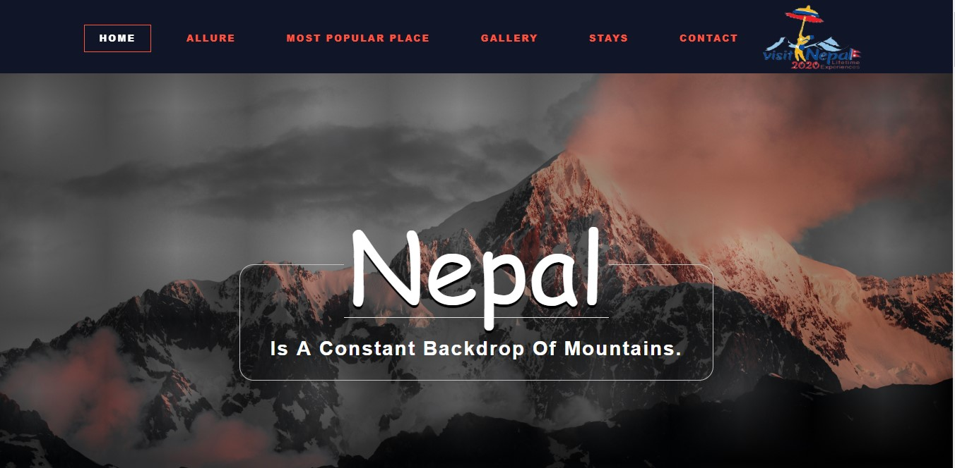

Slide 5
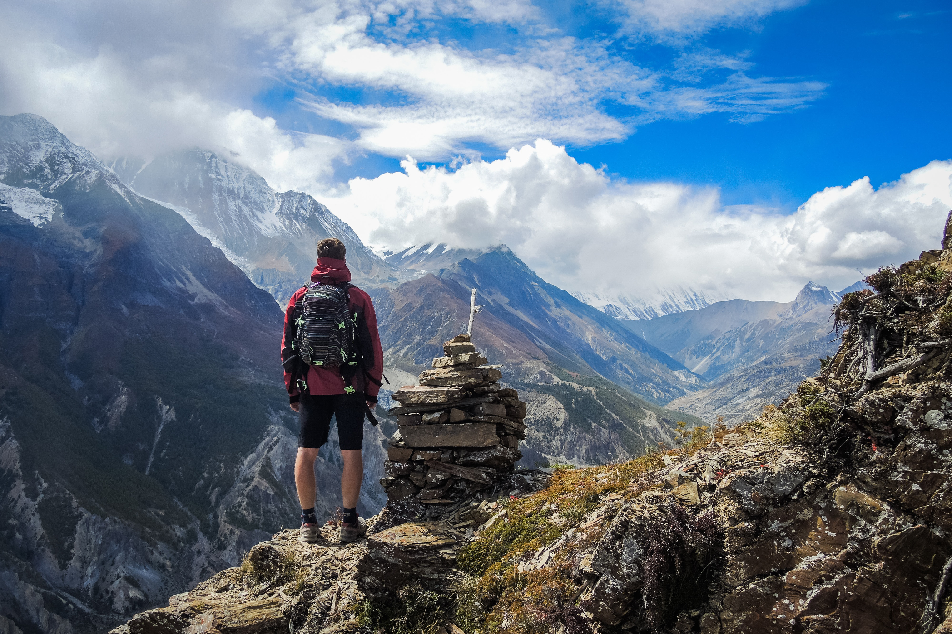

Yeti Costumer Assistance
Trip Planner
Places Near By
Weather Report
Currency Converter
Local Taste
Emergency Services
Chat with Yeti
How can I help you?

Slide 6
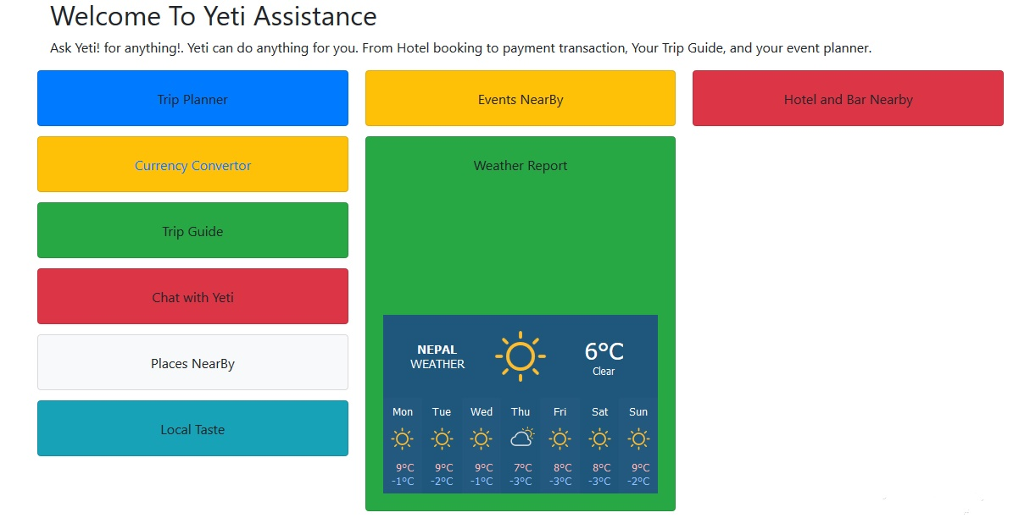

Slide 7
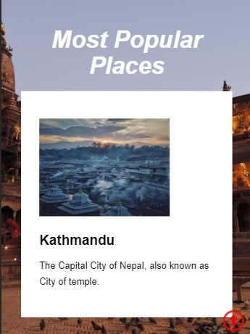
How to Start Being a Digital Traveler
Reduce and Eliminate Expenses
Decide on a Location
Set Goals and Create a Plan

Slide 8

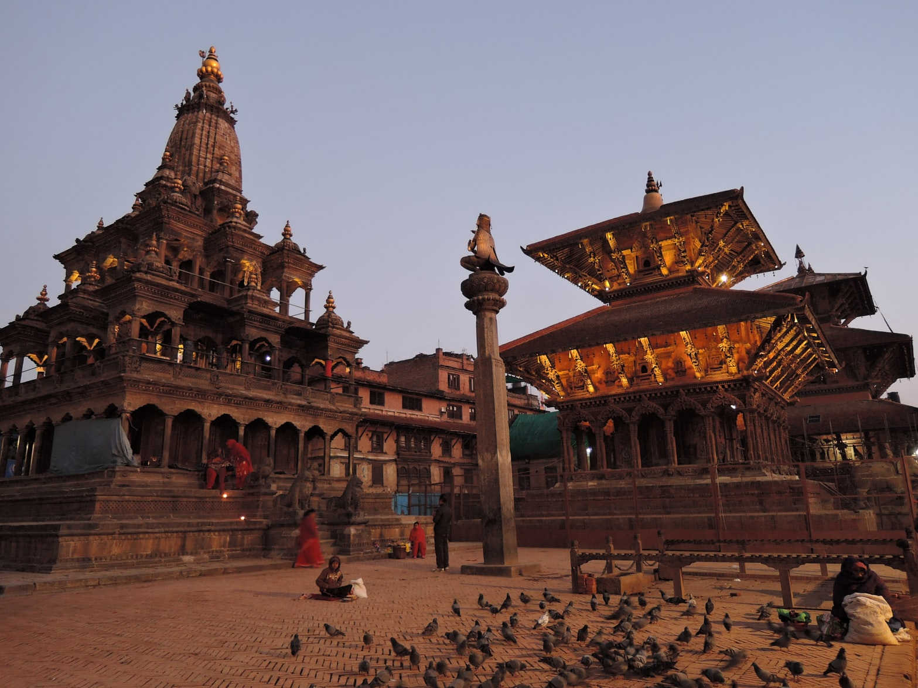

Make a Plan
Set a destination
1
Set mode of travel, and find accommodations
2
Find local attractions and activities
3

Slide 9
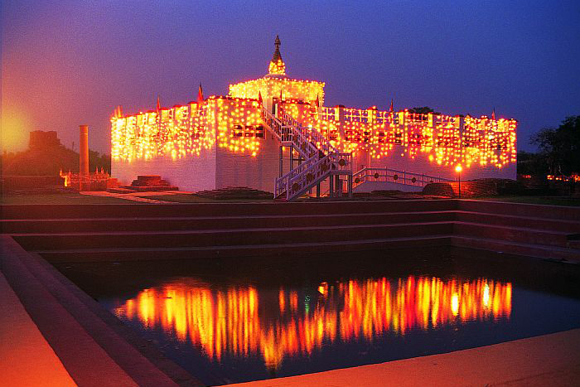
Thank you
Elite Team

